Slide 1

Rationale
Introduction to Windows Store App Development Using HTML5 and JavaScript
Computer science is a field of study that deals with solving a variety of problems by using computers.
  To solve a given problem by using computers, you need to design an algorithm for it.
Multiple algorithms can be designed to solve a particular problem.
An algorithm that provides the maximum efficiency should be used for solving the problem.
  The efficiency of an algorithm can be improved by using an appropriate data structure.
Data structures help in creating programs that are simple, reusable, and easy to maintain.
This module will enable a learner to select and implement an appropriate data structure and algorithm to solve a given programming problem.

Slide 2
Objectives
  In this session, you will learn to:
  Implement tile notification
Notes:
2

Slide 3



Demo: Implementing a Tile Notification
  Problem Statement:
  Allen is a Windows Store app developer. He has created a photo album app. The app displays the various photos available in the album, as shown in the following figure.

Slide 4
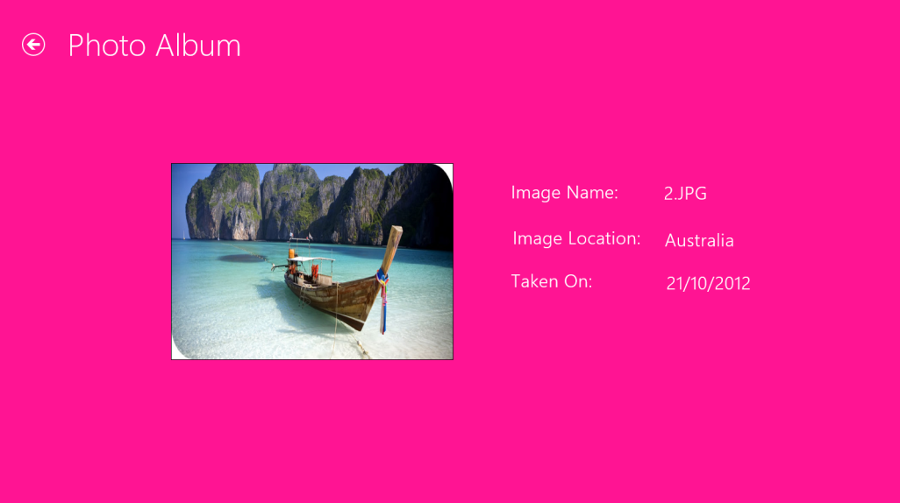
Demo: Implementing a Tile Notification (Contd.)
  Further, when a user clicks a photo, the app should navigate to a new page, which contains the photo and its description, as shown in the following figure.

Slide 5
Demo: Implementing a Tile Notification (Contd.)
  In addition, every such page should allow the user to go back to the main page of the app.
  Now, he needs to send a notification to the tile that will display the images from the collection one by one after every five seconds.
  Help Allen to develop the preceding app.

Slide 6
Demo: Implementing a Tile Notification (Contd.)
  Solution:
  To implement the required functionality, Allen needs to perform the following tasks:
    1. Send the notification to tile.
    2. Execute the app and verify the output.

Slide 7
Summary
  In this session, you learned that:
  To send notifications to a tile, you need to invoke the update() method of the TileUpdater class by using an instance of this class.
Notes:
7

Slide 8

Q&A

